Slide 1
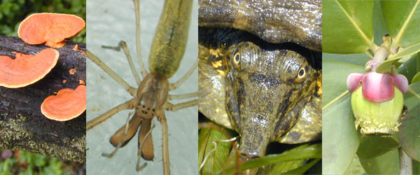
GENERAL BIOLOGY fdn 1203
Dr. Theja Abayarathna
Department of Biology
Faculty of Applied Sciences
Rajarata University of Sri Lanka

Slide 2
DYNAMICS OF THE Ecosystem

Slide 3
Dynamics of the ecosystem
every ecosystem has regulated transfer of energy and a controlled cycling of nutrients.
All of the substances cycle through ecosystems in biogeochemical cycles.

Slide 4
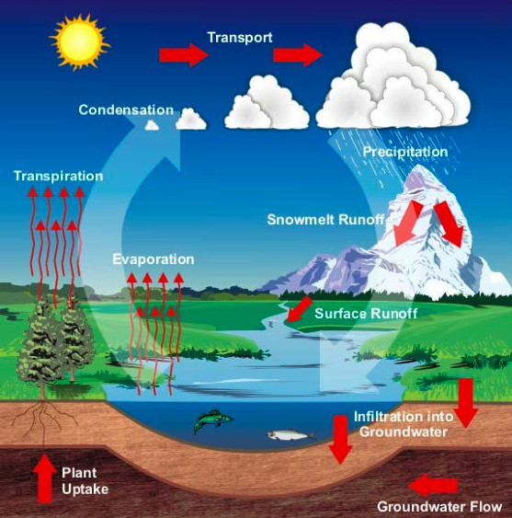
Water cycle

Slide 5
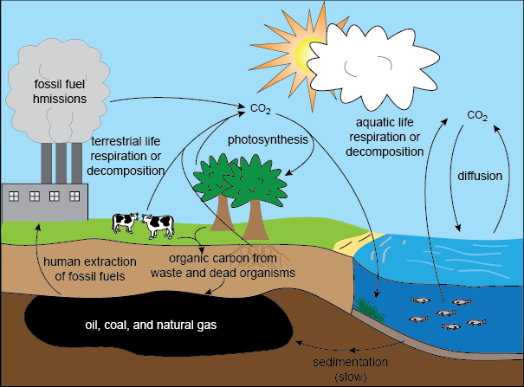
Carbon cycle

Slide 6
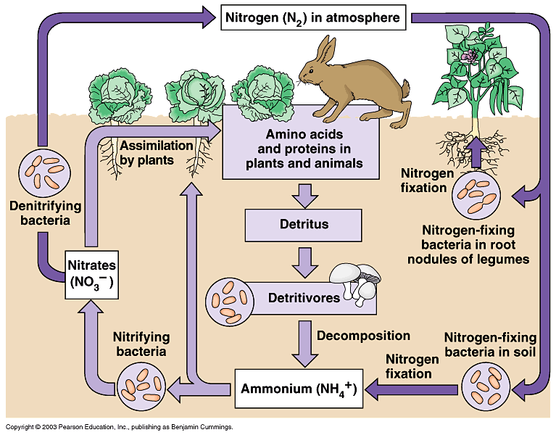
Nitrogen cycle

Slide 7
Trophic levels
An ecosystem is composed of autotrophs and heterotrophs.
Autotrophs are the plants, algae and some bacteria that are able to capture light energy and manufacture their own food.
They are primary producers.

Slide 8
Heterotrophs are the animals, fungi and most other organisms, who obtain organic molecules that have been synthesized by autotrophs.
They are consumers.

Slide 9
There are several different levels of consumers.
Primary consumers are herbivores.
They feed directly on the green plants.
Secondary consumers are carnivores and parasites of the animals feed in and on the herbivores.
Decomposers breakdown the organic matter accumulated in the bodies of other organisms.

Slide 10
All of these categories are occurred in any ecosystem.
They represent different “Trophic levels”
Organisms from each tropic level feed on one another make up a series called “food chain”

Slide 11
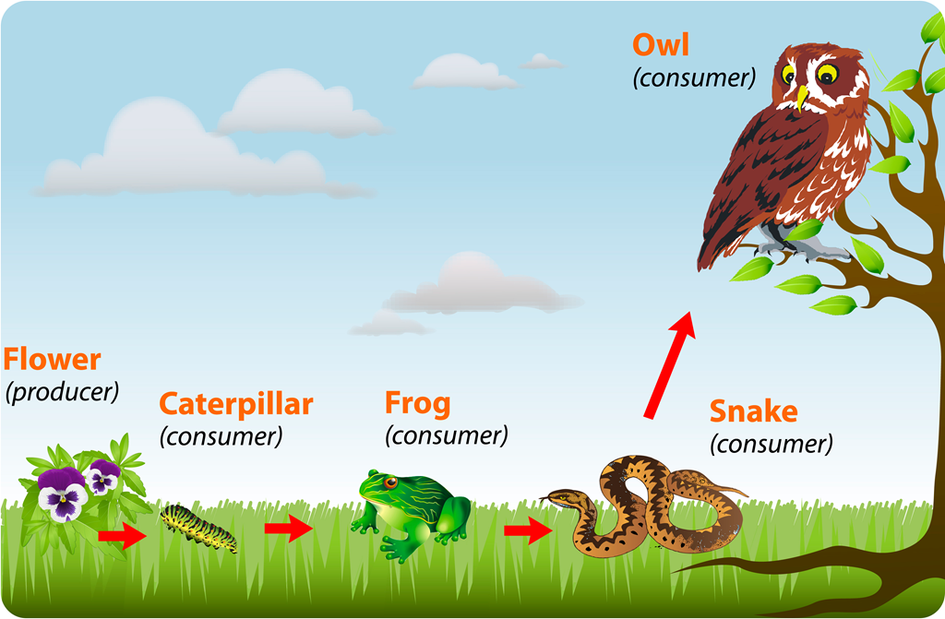

An example for a food chain

Slide 12
In real life it is rare for a given kind of organism to feed only on one other type of organism.
Usually each organism feed on 2 or more kinds and it is eaten by several other kinds of organisms.
When diagrammed it appears as a series of branching lines, than a straight line.
It is called a food web.

Slide 13
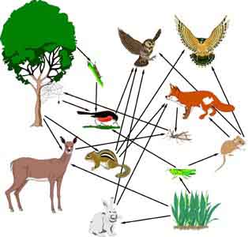
An example for a food web

Slide 14
Thank you!

